Slide 1
Solar power
Renewable energy source
Variable/Intermittent production
Seasonal/daily/hourly variations
Low O&M costs
Moderate to high investment cost (but fast decrease)
Energy output is site specific
Notes:
Typical characteristics of solar power

Slide 2
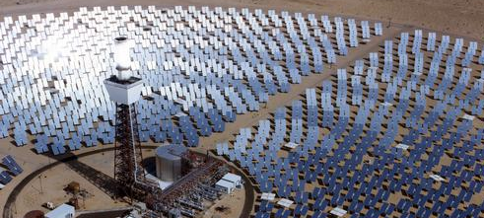
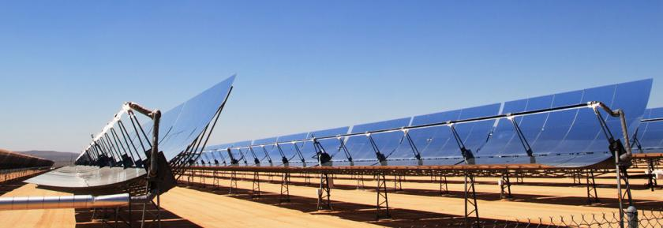
Solar power technologies
Solar-thermally generated electricity:
  Complex collectors to gather solar radiation to produce temperatures high enough to drive steam turbines to produce electric power.
  For example, a turbine fed from parabolic through collectors might take steam at 750 K and eject heat into atmosphere at 300 K will have a ideal thermal (Carnot) efficiency of about 60%. Realistic overall conversion (system) efficiency of about 35% is feasible.
Notes:
Image source: https://www.ucsusa.org/clean-energy/renewable-energy/concentrating-solar-power-plants#.WyLj3YozaUk

Slide 3
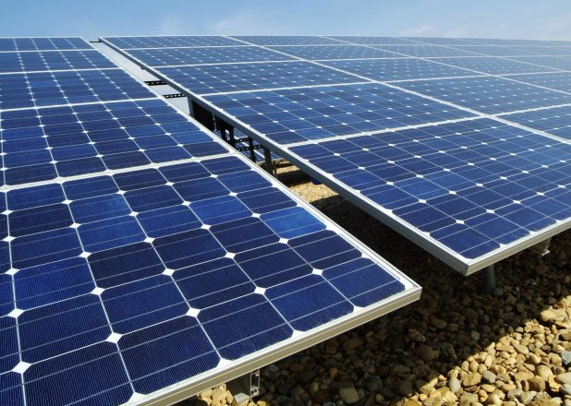
Solar power technologies
Photovoltaic energy:
  Direct conversion of sun’s rays to electricity.
  The efficiency (the ratio of the maximum power output and the incident radiation flux) of the best single-junction silicon solar cells has now reached 46% in laboratory test conditions.
  The best silicon commercially available PV modules have an efficiency of about 20%.
Notes:
Image source: http://www.incoreinsightlytics.com/selection-of-solar-power-developers-for-2000-mw-grid-connected-solar-pv-power-plants/

Slide 4
Solar with storage
CSP may be built with energy/heat storage
PV also can have storage (batteries)
Modeling of the storage for solar energy depends on the design of the facility, can be done in two ways:
  Adjusted production curves of solar plant (usually enough for long-term modelling)
  Storage as an additional element in the model (similar to hydro storage)

Slide 5
PV and CSP
Key characteristics
Utility PV
Capital cost | 1700-2100 $/kW
FOM cost | 1% of capital / year
VOM cost | 0 $/GJ
Life-cycle CO2 emission factor | 12-25 gCO2/kWh
Avg. capacity factor | 13%
Lifetime | 25 years
CSP (no storage)
Capital cost | 4500-8000 $/kW
FOM cost | 25-35 $/kW/a
VOM cost | 0 $/GJ
Efficiency | 13-15%
Avg. capacity factor | 25-28%
If the exact same (group of) solar power unit(s) is installed in different locations, the parameter that changes is the CapacityFactor.
In countries with good solar resources, PV has reached the so called grid-parity. In others, not yet competitive.
Most diffused commercial PV techs are wafer-based crystalline silicon and thin film. The latter is cheap (the production chain is similar to the one of LCD) but less efficient.
CSP not yet competitive, but potential if market increases.

Slide 6
PV and CSP
If the exact same (group of) solar power unit(s) is installed in different locations, the parameter that changes is the CapacityFactor.
In countries with good solar resources, PV has reached the so called grid-parity. In others, not yet competitive.
Most diffused commercial PV techs are wafer-based crystalline silicon and thin film. The latter is cheap (the production chain is similar to the one of LCD) but less efficient.
CSP not yet competitive, but potential if market increases.
Key characteristics
Residential PV
Capital cost | 2200-4500 $/kW
FOM cost | 1% of capital/year
VOM cost | 0 $/GJ
Life-cycle CO2 emission factor | 12-25 gCO2/kWh
Avg. capacity factor | 13%
Lifetime | 25 years

